Slide 1
CAREER INFORMATION

Slide 2
At Cambian Wing College we are proud to deliver the Gatsby Benchmark Guidance which is as follows:

Slide 3
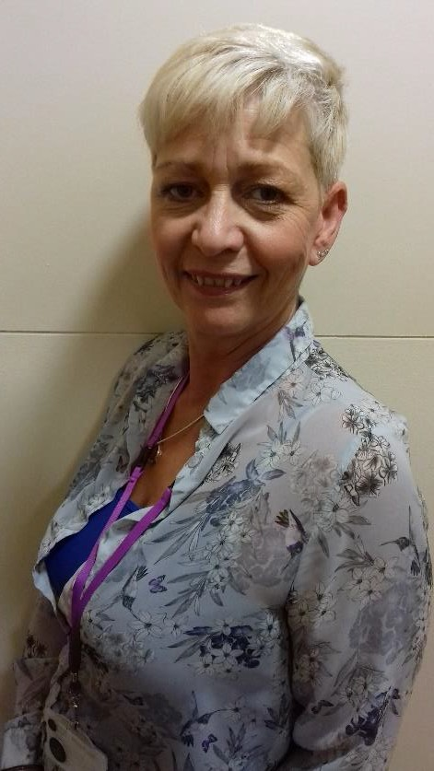
Students throughout the year have taught sessions with Cambian Wing College, Employability Co-ordinator – Angela Lawrence. Her sessions include CV writing, cover letters, applications and interview techniques. Along with the skills needed to hold down a job/career. Students can also access information relating to work experience, supported internships and apprenticeship opportunities.
Definitions:
Work Experience – a short-term experience of employment
Supported Internships – are a structured study programme based primarily with an employer. They enable young people aged 16-24 with a statement of SEN, or an Education, Health and Care plan to achieve sustainable paid employment by equipping them with the skills they need for work, through learning in the workplace
Apprenticeships - a job that includes gaining recognised qualifications and essential skills whilst you are working

Slide 5
•
•
•
•
•
•
•
•
•
Claire King – Occupational Therapist
Nicole Washington – Speech and Language Therapist

Slide 6
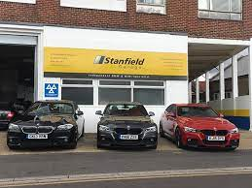

Slide 7
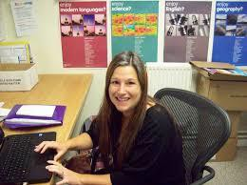
Louise Evenden
Independent Careers Adviser
Email: l.a.evenden@gmail.com
Phone: 07882019741

